Slide 1
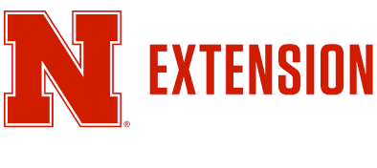
Nebraska Climate Update
CARC Meeting
7 November 2023
Eric Hunt
ehunt2@unl.edu
402-617-4190

Slide 2
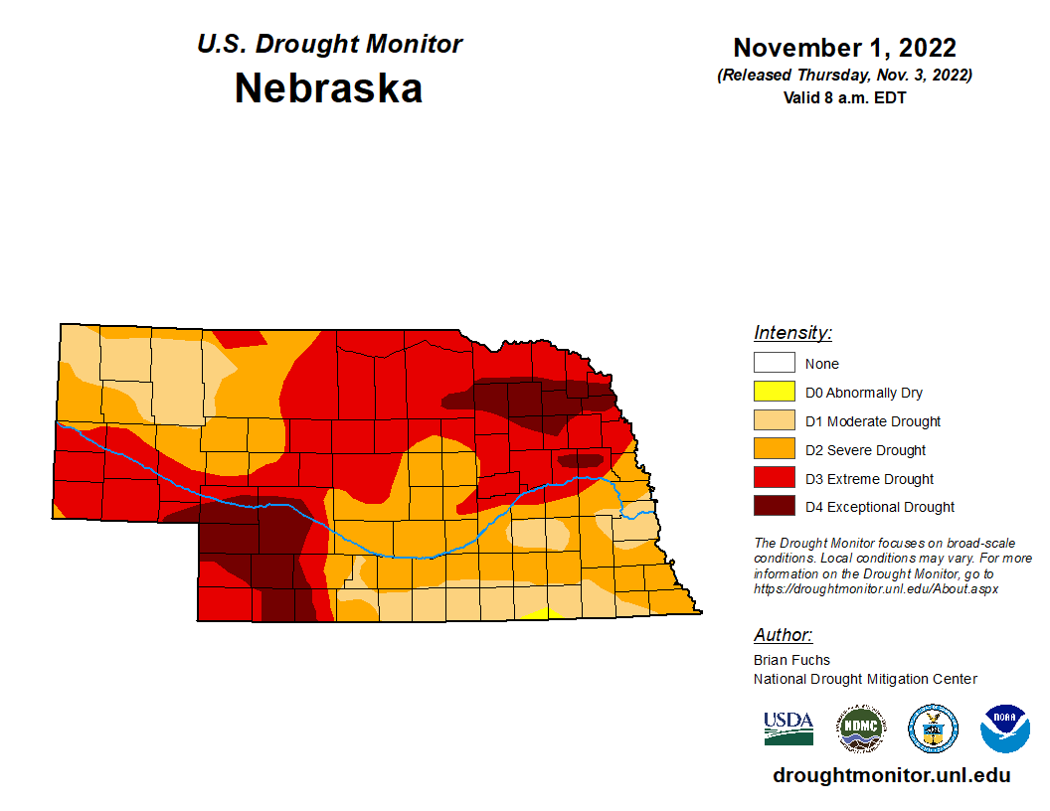
Drought in perspective
Conditions one year ago in Nebraska:
- Almost 100% of state in drought.
- Conditions worst in northeast and southwest NE.
- 2022 was the driest year on record in Norfolk (13.27”)
Source: https://droughtmonitor.unl.edu/maps/
Notes:
Here I outlined the similar trends for the Nebraska and global annual average temperature. I also point out the high variability in Nebraska and difference in regional vs. global scales. I use the analogy that global change is like an escalator that is increasing at an accelerating rate. The variability is like we jump up or down a few steps while still going up.

Slide 3
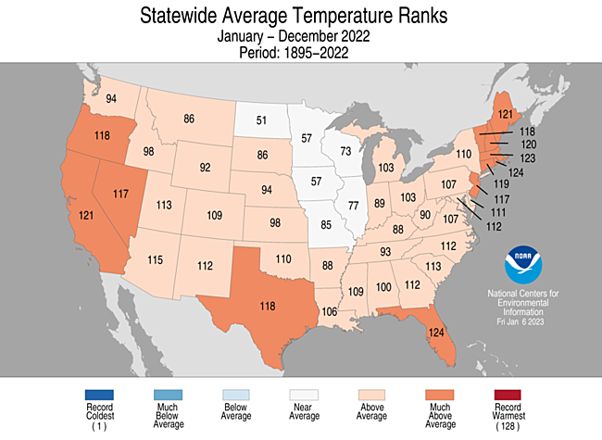
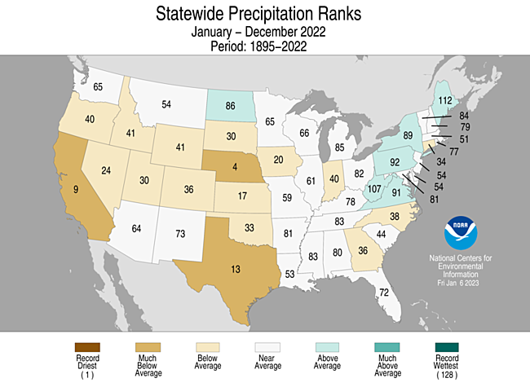
2022 Review
Warmer than average
One of the driest on record
Notes:
Here I outlined the similar trends for the Nebraska and global annual average temperature. I also point out the high variability in Nebraska and difference in regional vs. global scales. I use the analogy that global change is like an escalator that is increasing at an accelerating rate. The variability is like we jump up or down a few steps while still going up.

Slide 4
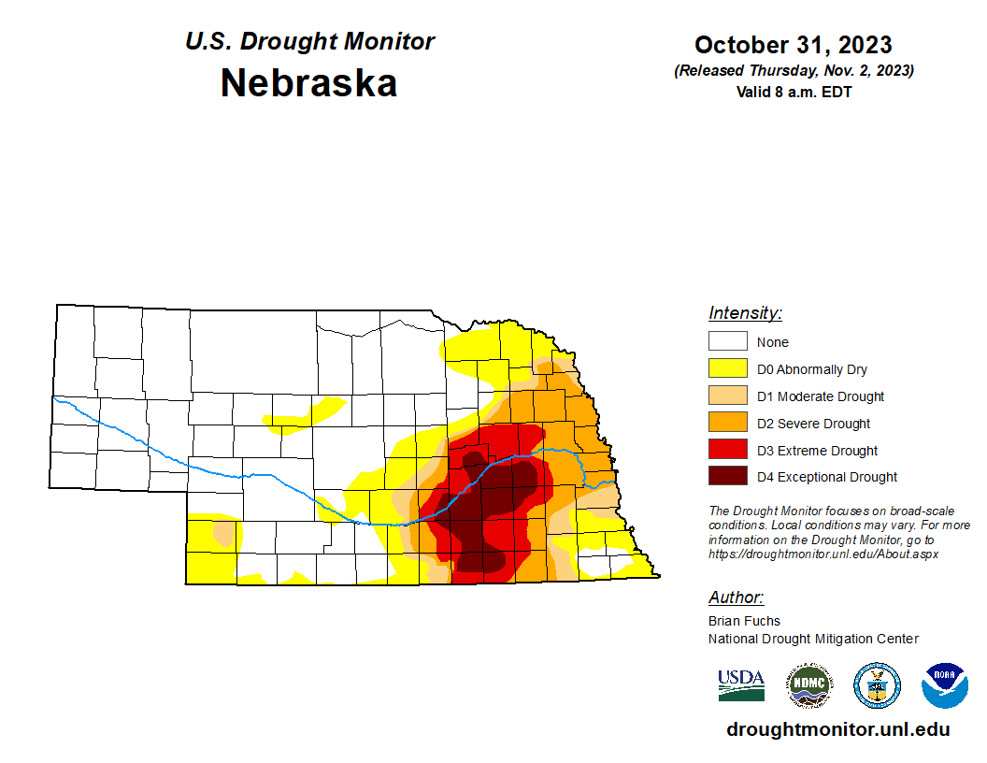
Drought in perspective
Conditions now ago in Nebraska:
- 24.8% in drought
- Degradation in east-south central NE.
- Significant improvement western and north central NE
Source: https://droughtmonitor.unl.edu/maps/
Notes:
Here I outlined the similar trends for the Nebraska and global annual average temperature. I also point out the high variability in Nebraska and difference in regional vs. global scales. I use the analogy that global change is like an escalator that is increasing at an accelerating rate. The variability is like we jump up or down a few steps while still going up.

Slide 5
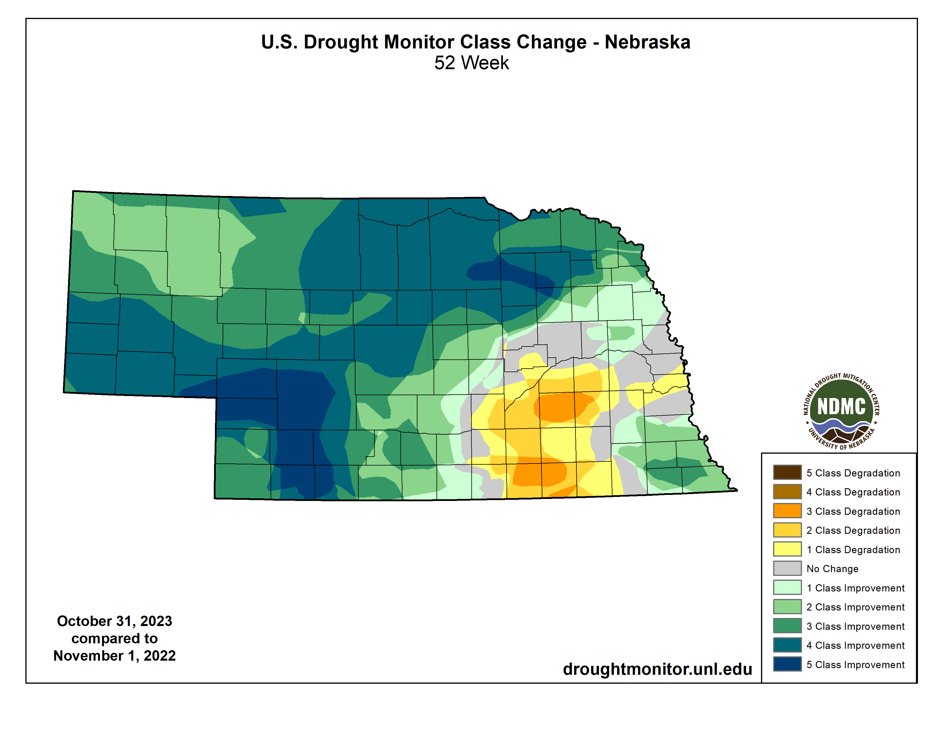
Drought in perspective
- Drought conditions have improved considerably in most of the state
- Exception is parts of eastern and south central NE
Source: https://droughtmonitor.unl.edu/maps/
Notes:
Here I outlined the similar trends for the Nebraska and global annual average temperature. I also point out the high variability in Nebraska and difference in regional vs. global scales. I use the analogy that global change is like an escalator that is increasing at an accelerating rate. The variability is like we jump up or down a few steps while still going up.

Slide 6
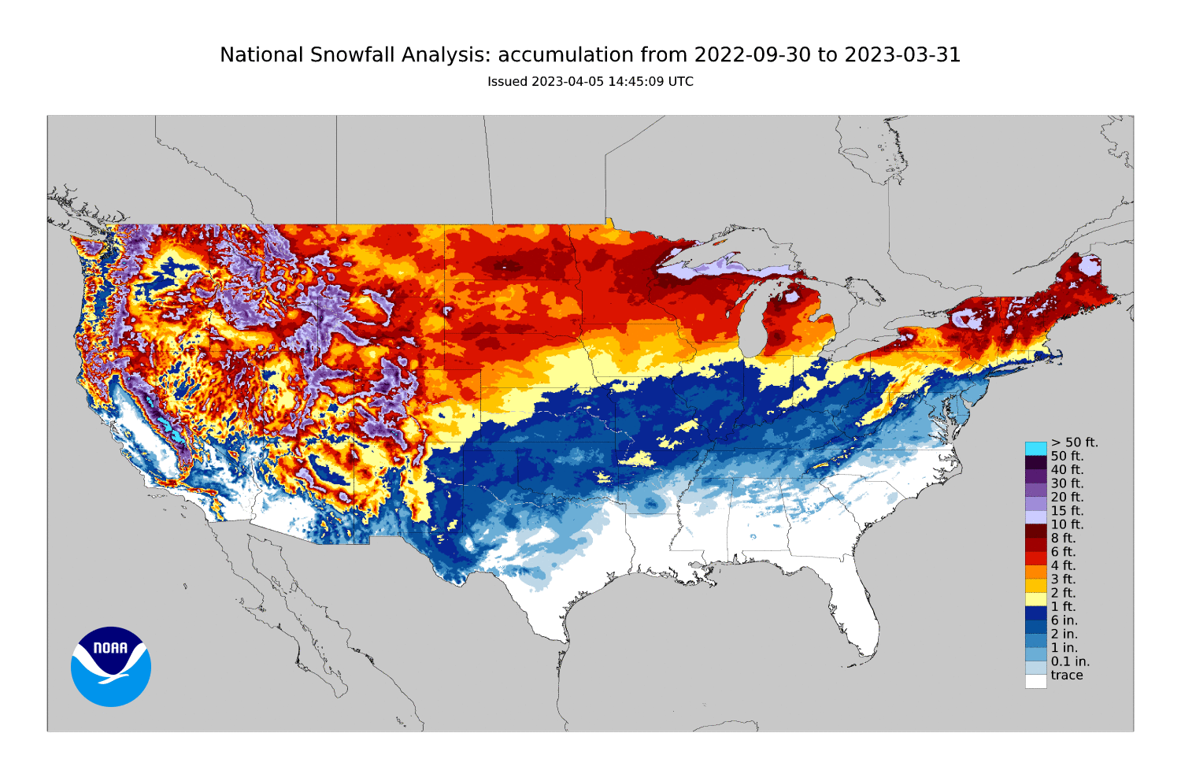
2022-2023 snow
Heavy snowfall in the Panhandle and north central regions
Notes:
Here I outlined the similar trends for the Nebraska and global annual average temperature. I also point out the high variability in Nebraska and difference in regional vs. global scales. I use the analogy that global change is like an escalator that is increasing at an accelerating rate. The variability is like we jump up or down a few steps while still going up.

Slide 7
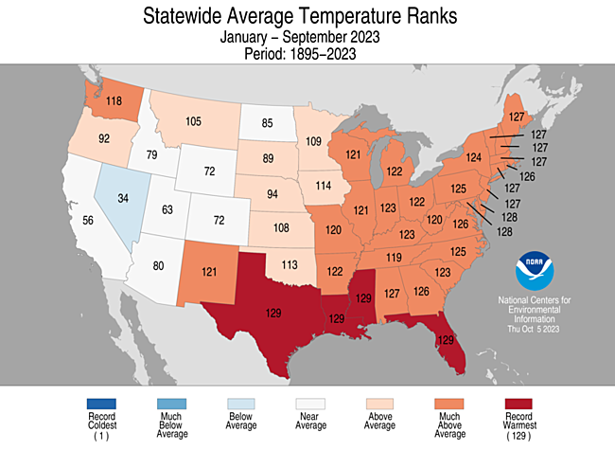
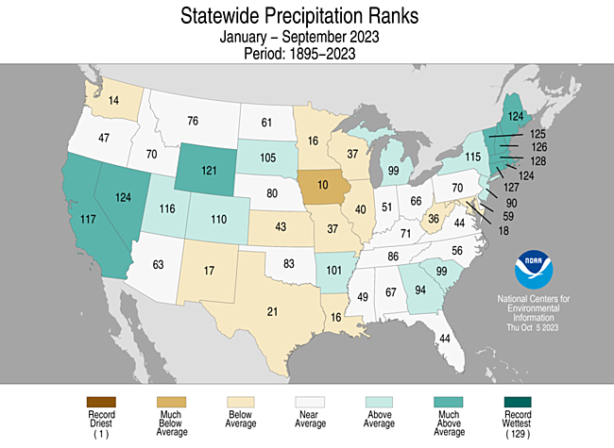
2023 (through September)
Still above average temperatures but much wetter than 2022
Notes:
Here I outlined the similar trends for the Nebraska and global annual average temperature. I also point out the high variability in Nebraska and difference in regional vs. global scales. I use the analogy that global change is like an escalator that is increasing at an accelerating rate. The variability is like we jump up or down a few steps while still going up.

Slide 8
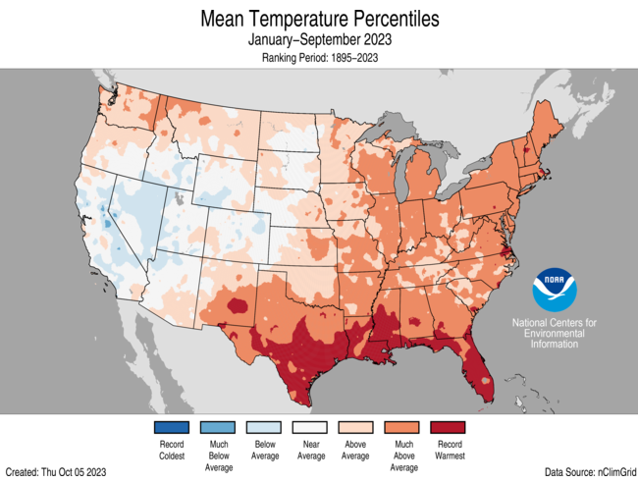
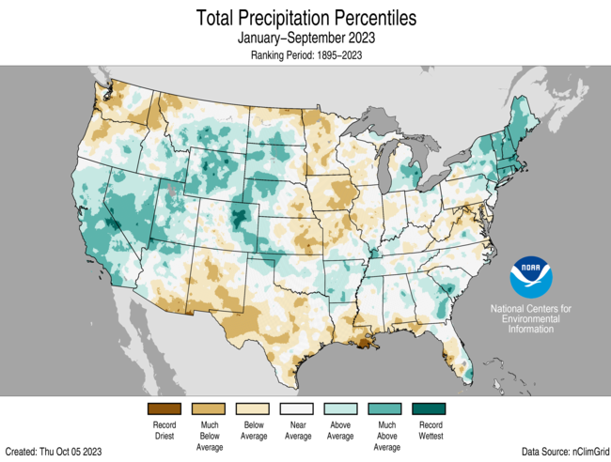
2023 percentiles
A tale of two states: warm and dry in the east, much wetter and near average temperatures in the west
Notes:
Here I outlined the similar trends for the Nebraska and global annual average temperature. I also point out the high variability in Nebraska and difference in regional vs. global scales. I use the analogy that global change is like an escalator that is increasing at an accelerating rate. The variability is like we jump up or down a few steps while still going up.

Slide 9
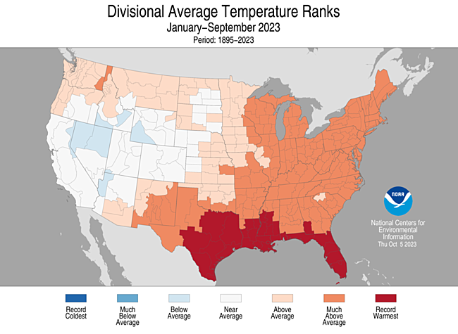
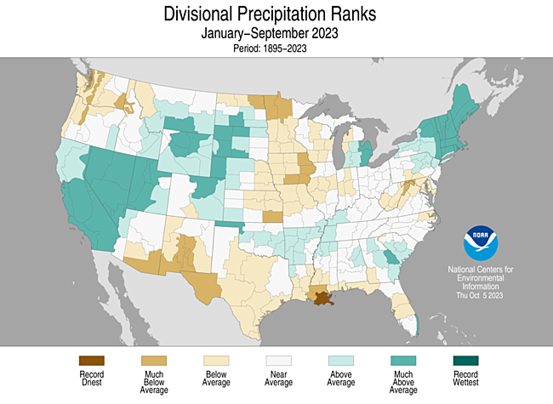
2023 climate division ranks
A tale of two states: warm and dry in the east, much wetter and near average temperatures in the west
Notes:
Here I outlined the similar trends for the Nebraska and global annual average temperature. I also point out the high variability in Nebraska and difference in regional vs. global scales. I use the analogy that global change is like an escalator that is increasing at an accelerating rate. The variability is like we jump up or down a few steps while still going up.

Slide 10
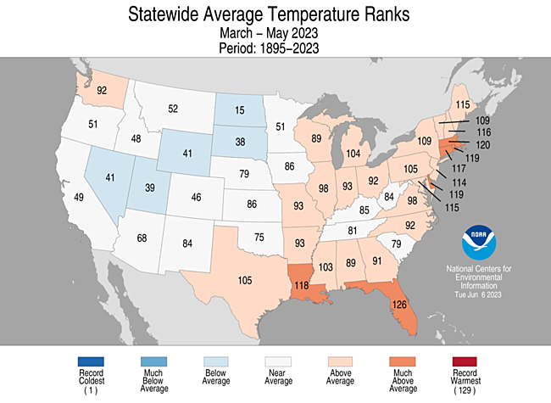
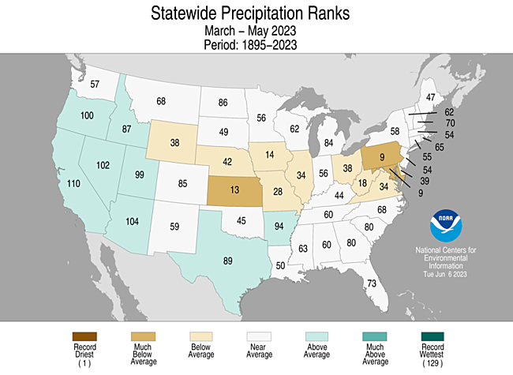
2023 spring ranks
Drier than average and near-average temperatures
Notes:
Here I outlined the similar trends for the Nebraska and global annual average temperature. I also point out the high variability in Nebraska and difference in regional vs. global scales. I use the analogy that global change is like an escalator that is increasing at an accelerating rate. The variability is like we jump up or down a few steps while still going up.

Slide 11
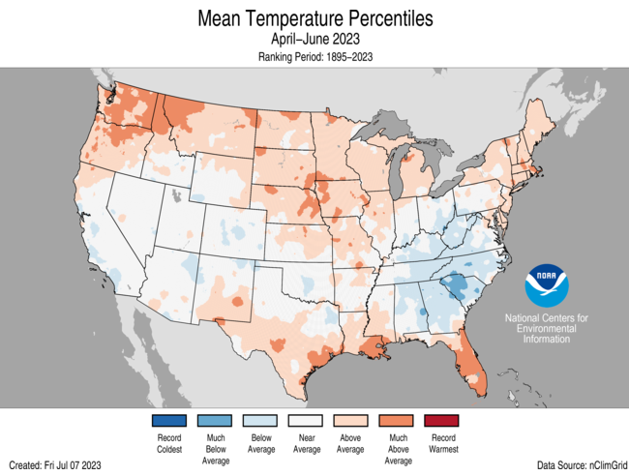
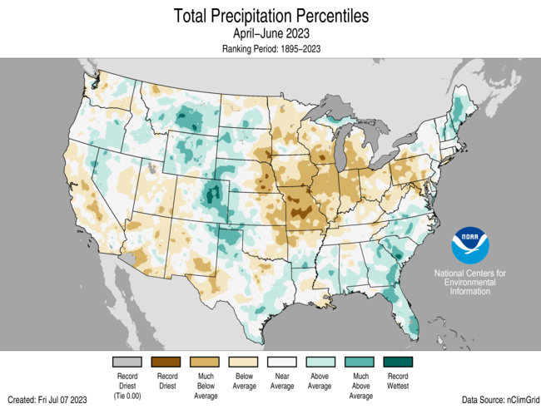
2023 spring percentiles
Warmer than average. Drier than average east and wetter than average west.
Notes:
Here I outlined the similar trends for the Nebraska and global annual average temperature. I also point out the high variability in Nebraska and difference in regional vs. global scales. I use the analogy that global change is like an escalator that is increasing at an accelerating rate. The variability is like we jump up or down a few steps while still going up.

Slide 12
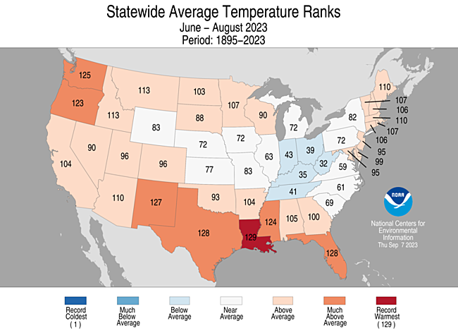
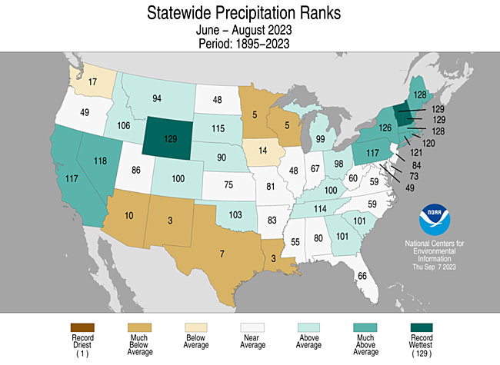
2023 summer ranks
Wetter than average and near-average temperatures
Notes:
Here I outlined the similar trends for the Nebraska and global annual average temperature. I also point out the high variability in Nebraska and difference in regional vs. global scales. I use the analogy that global change is like an escalator that is increasing at an accelerating rate. The variability is like we jump up or down a few steps while still going up.

Slide 13
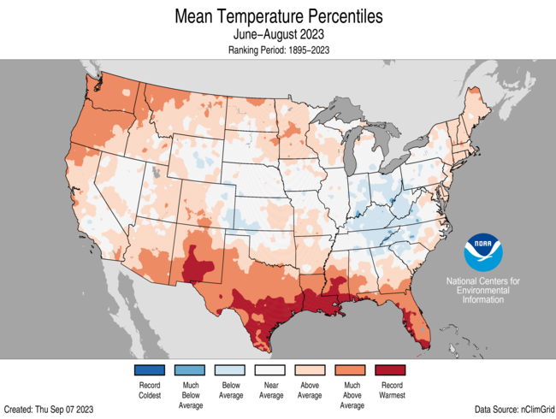
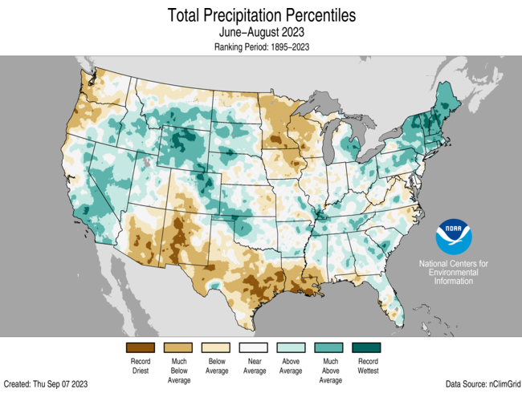
2023 summer percentiles
Wetter than average and near-average temperatures
Notes:
Here I outlined the similar trends for the Nebraska and global annual average temperature. I also point out the high variability in Nebraska and difference in regional vs. global scales. I use the analogy that global change is like an escalator that is increasing at an accelerating rate. The variability is like we jump up or down a few steps while still going up.

Slide 14
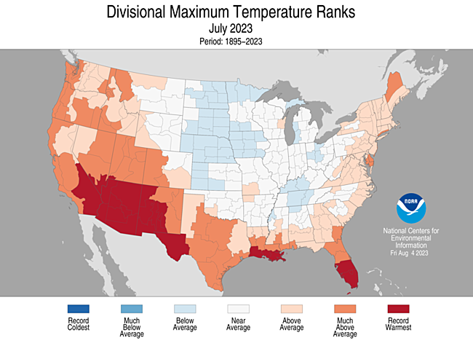
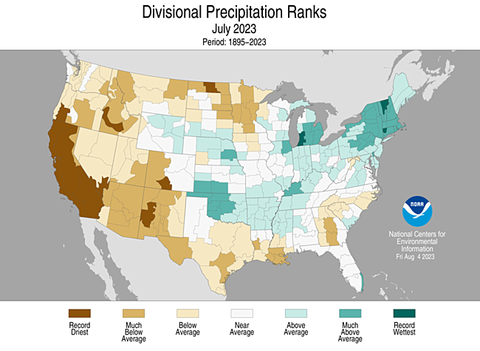
July 2023 climate division ranks
Cooler than average statewide and generally wet
Notes:
Here I outlined the similar trends for the Nebraska and global annual average temperature. I also point out the high variability in Nebraska and difference in regional vs. global scales. I use the analogy that global change is like an escalator that is increasing at an accelerating rate. The variability is like we jump up or down a few steps while still going up.

Slide 15
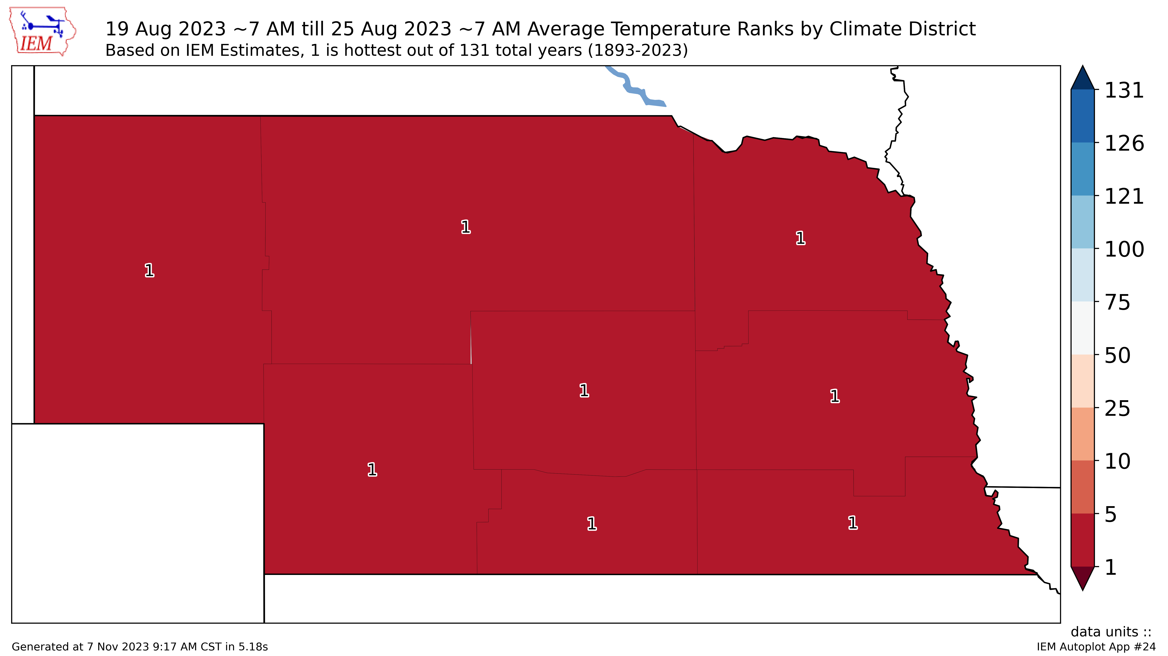
August heat wave
For the week of 8/19-8/25, it was the hottest common period on record
Notes:
Here I outlined the similar trends for the Nebraska and global annual average temperature. I also point out the high variability in Nebraska and difference in regional vs. global scales. I use the analogy that global change is like an escalator that is increasing at an accelerating rate. The variability is like we jump up or down a few steps while still going up.

Slide 16
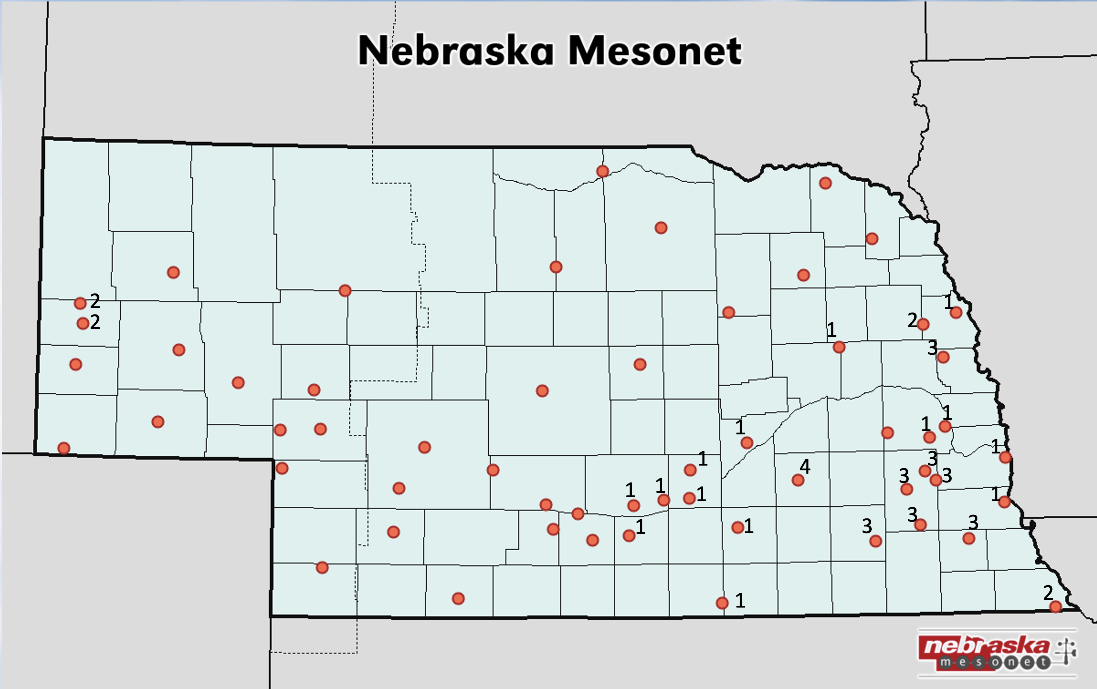
August heat wave
Number of days the cattle comfort index was in extreme danger category
Notes:
Here I outlined the similar trends for the Nebraska and global annual average temperature. I also point out the high variability in Nebraska and difference in regional vs. global scales. I use the analogy that global change is like an escalator that is increasing at an accelerating rate. The variability is like we jump up or down a few steps while still going up.

Slide 17
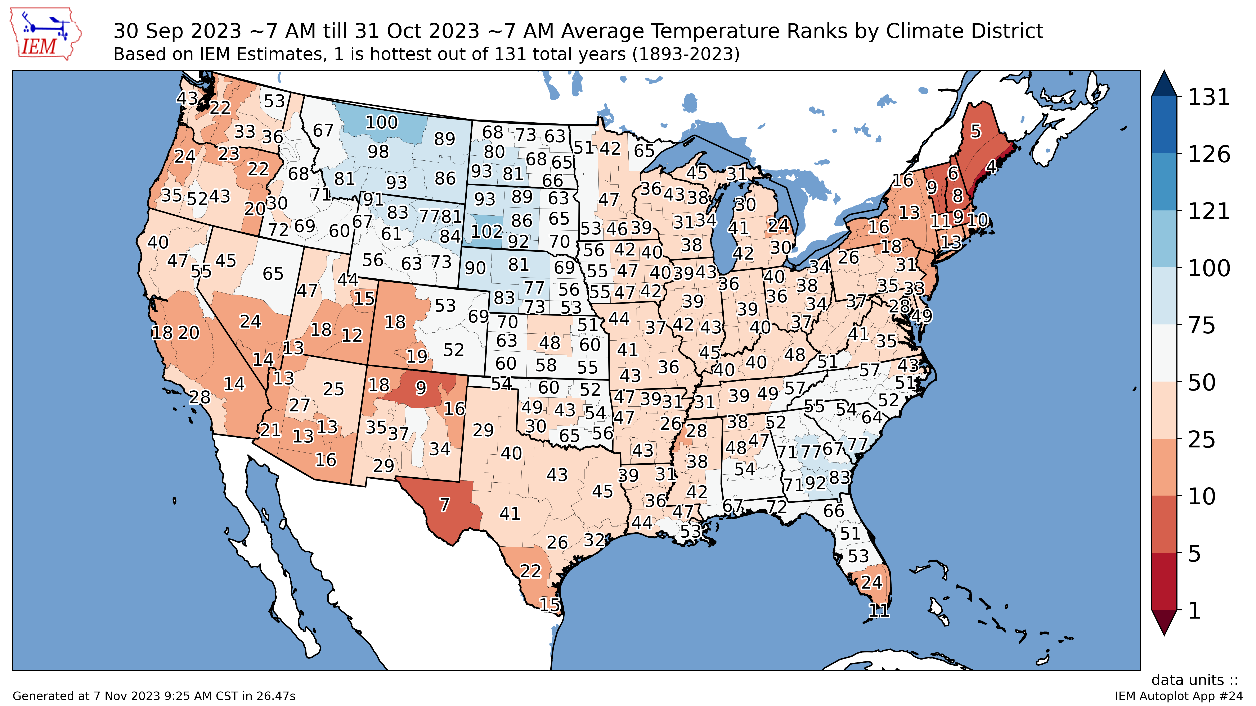
October 2023 (preliminary)
Notes:
Here I outlined the similar trends for the Nebraska and global annual average temperature. I also point out the high variability in Nebraska and difference in regional vs. global scales. I use the analogy that global change is like an escalator that is increasing at an accelerating rate. The variability is like we jump up or down a few steps while still going up.

Slide 18
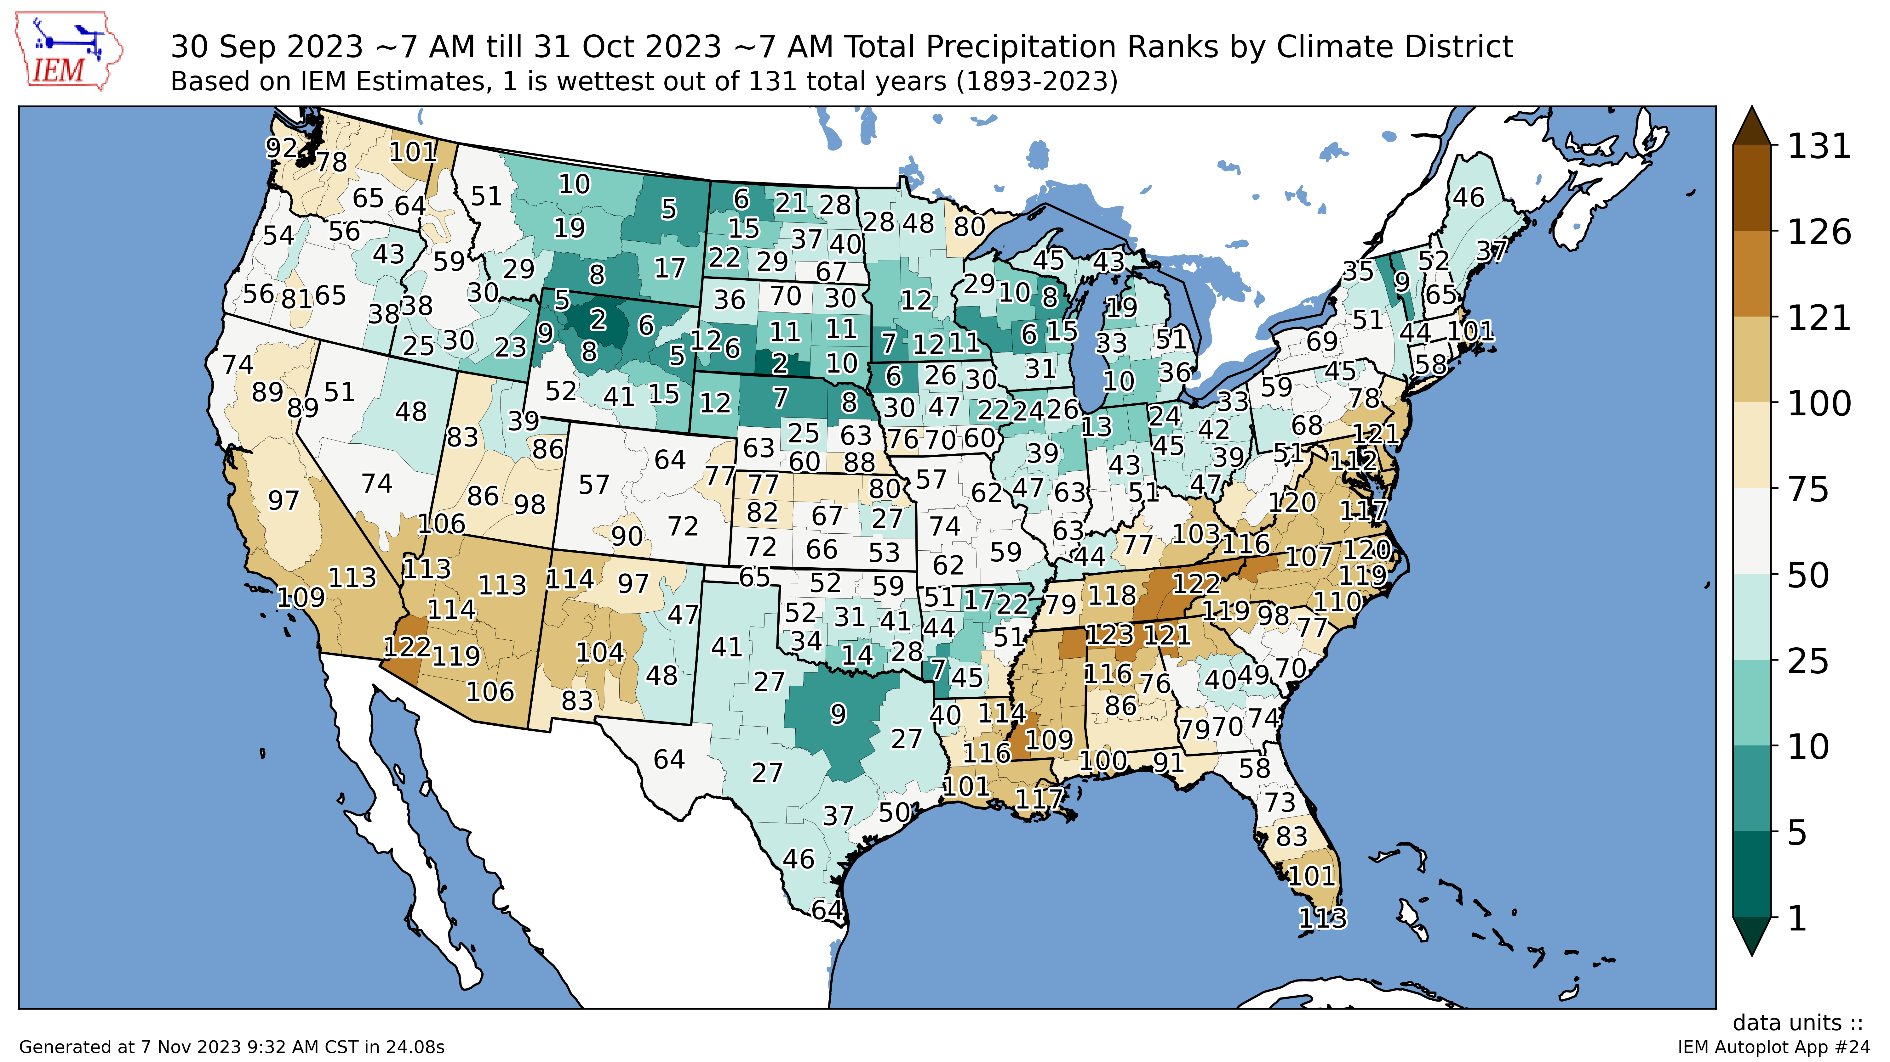
October 2023 (preliminary)
Notes:
Here I outlined the similar trends for the Nebraska and global annual average temperature. I also point out the high variability in Nebraska and difference in regional vs. global scales. I use the analogy that global change is like an escalator that is increasing at an accelerating rate. The variability is like we jump up or down a few steps while still going up.

Slide 19
2023 precipitation:
Notes:
Here I outlined the similar trends for the Nebraska and global annual average temperature. I also point out the high variability in Nebraska and difference in regional vs. global scales. I use the analogy that global change is like an escalator that is increasing at an accelerating rate. The variability is like we jump up or down a few steps while still going up.

Slide 20
2023 precipitation:
Notes:
Here I outlined the similar trends for the Nebraska and global annual average temperature. I also point out the high variability in Nebraska and difference in regional vs. global scales. I use the analogy that global change is like an escalator that is increasing at an accelerating rate. The variability is like we jump up or down a few steps while still going up.

Slide 21
2023 precipitation:
Notes:
Here I outlined the similar trends for the Nebraska and global annual average temperature. I also point out the high variability in Nebraska and difference in regional vs. global scales. I use the analogy that global change is like an escalator that is increasing at an accelerating rate. The variability is like we jump up or down a few steps while still going up.

Slide 22
2023 precipitation:
Notes:
Here I outlined the similar trends for the Nebraska and global annual average temperature. I also point out the high variability in Nebraska and difference in regional vs. global scales. I use the analogy that global change is like an escalator that is increasing at an accelerating rate. The variability is like we jump up or down a few steps while still going up.

Slide 23
2023 precipitation:
Notes:
Here I outlined the similar trends for the Nebraska and global annual average temperature. I also point out the high variability in Nebraska and difference in regional vs. global scales. I use the analogy that global change is like an escalator that is increasing at an accelerating rate. The variability is like we jump up or down a few steps while still going up.

Slide 24
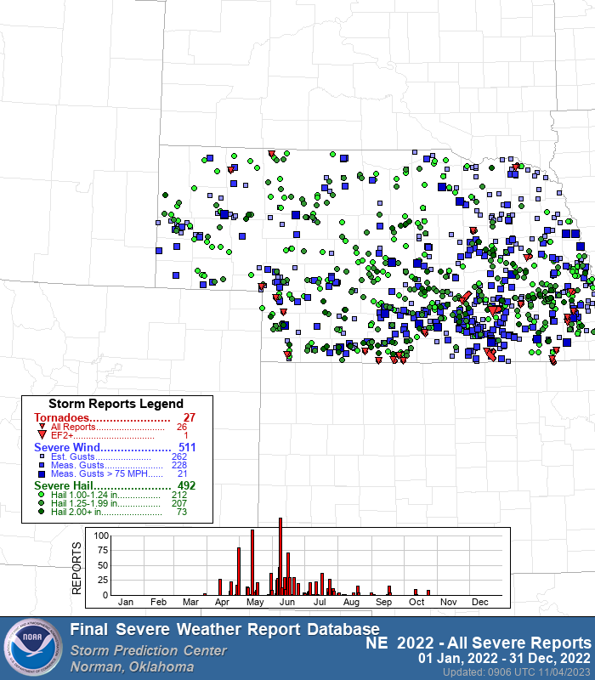
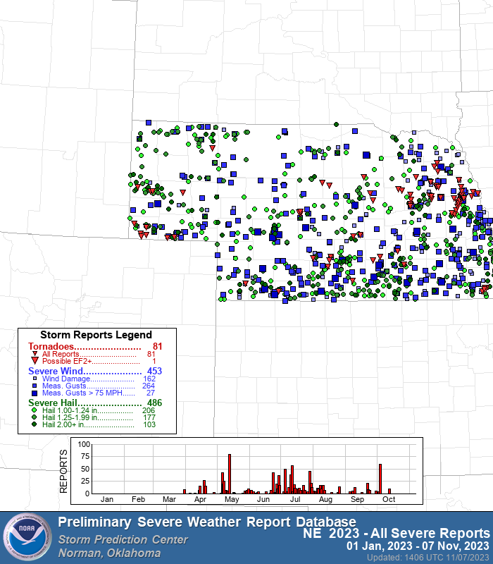
Severe storms report
Notes:
Here I outlined the similar trends for the Nebraska and global annual average temperature. I also point out the high variability in Nebraska and difference in regional vs. global scales. I use the analogy that global change is like an escalator that is increasing at an accelerating rate. The variability is like we jump up or down a few steps while still going up.

Slide 25
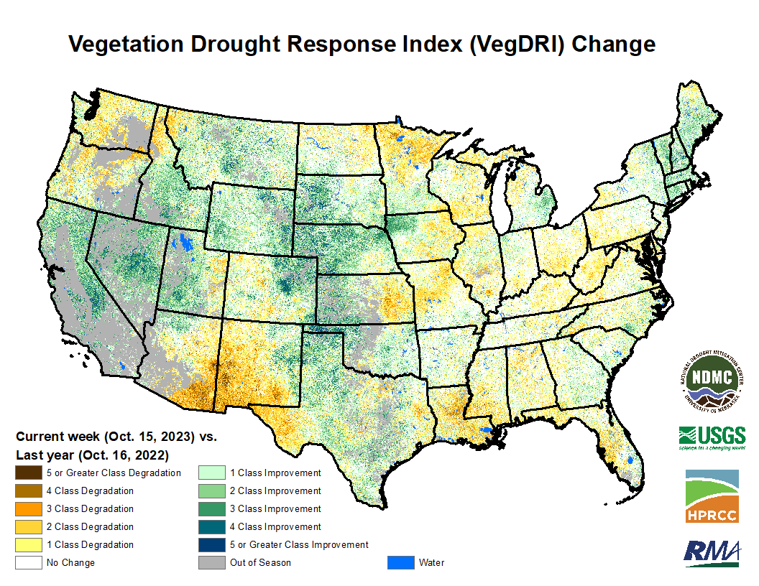
Impacts – pasture/range
Statewide NASS condition (as of 29 October: 51% G-E, 17 % P-VP)
One year ago: 2% G-E, 82% P-VP
Notes:
Here I outlined the similar trends for the Nebraska and global annual average temperature. I also point out the high variability in Nebraska and difference in regional vs. global scales. I use the analogy that global change is like an escalator that is increasing at an accelerating rate. The variability is like we jump up or down a few steps while still going up.

Slide 26
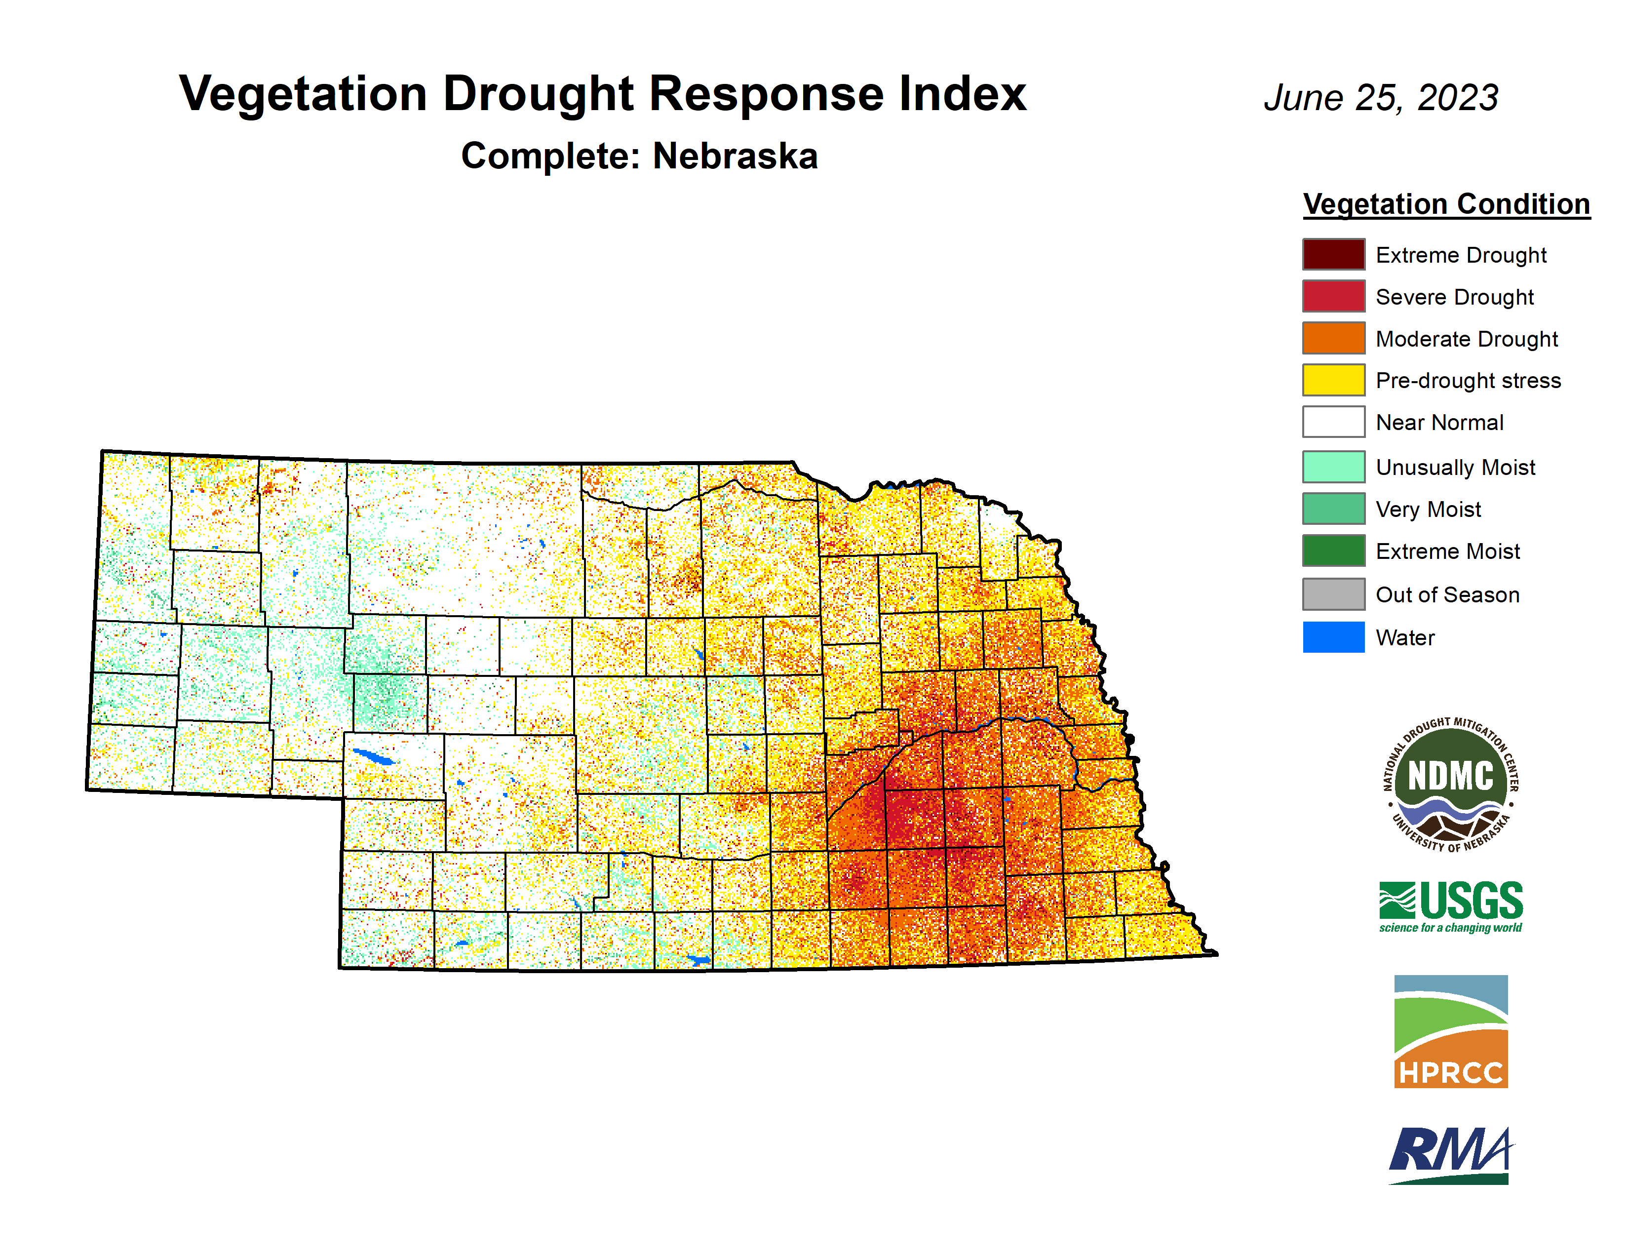
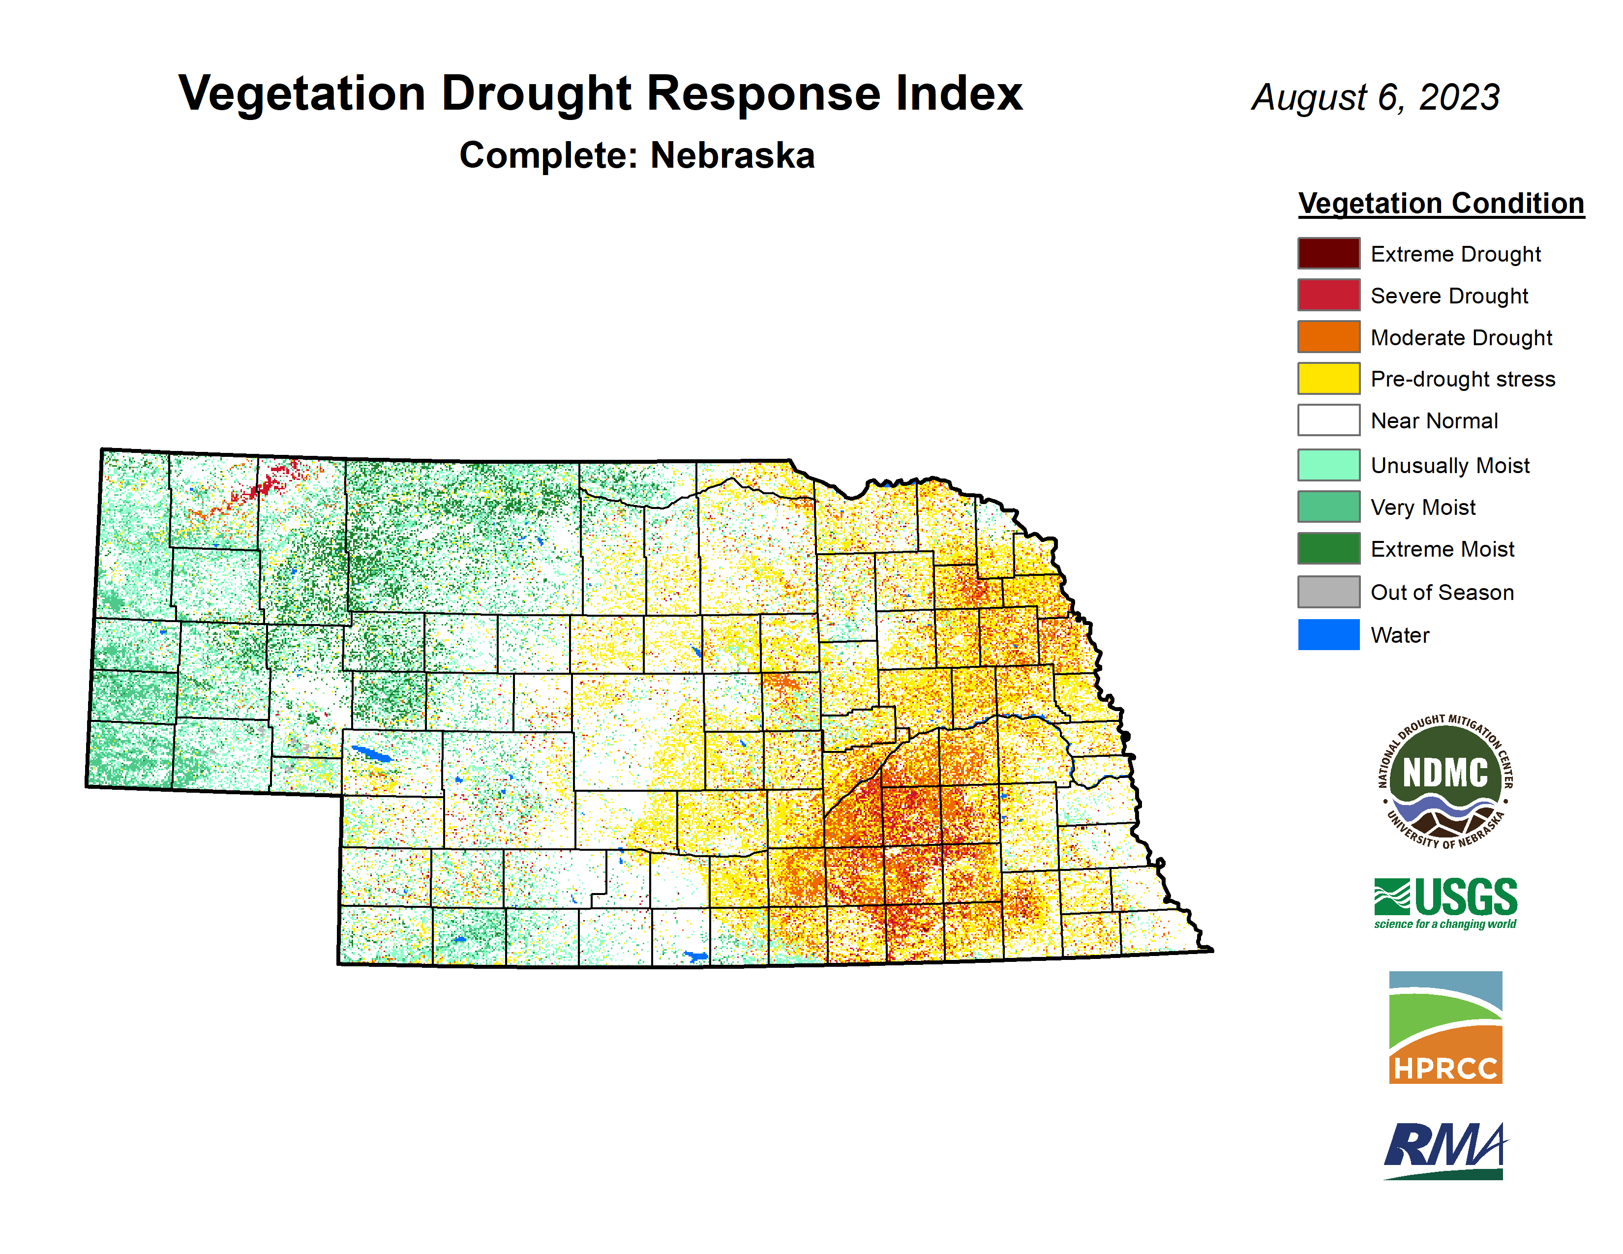
Total crop disaster averted?
Notes:
Here I outlined the similar trends for the Nebraska and global annual average temperature. I also point out the high variability in Nebraska and difference in regional vs. global scales. I use the analogy that global change is like an escalator that is increasing at an accelerating rate. The variability is like we jump up or down a few steps while still going up.

Slide 27
ehunt2@unl.edu 402-472-6711

